Slide 1
Post-Processing IBAMR Simulation Data in VisIt on a Computing Cluster
A contribution to the IBAMR Tutorials Research Group
9/23/2020
A Tutorial
Gabrielle Hobson
Scripps Institution for Oceanography at UCSD

Slide 2
Contents
Installing VisIt on the cluster
Creating a Python script to visualize data
Running your script on the cluster
IBFE meshes and displacement operators
Resampling velocity fields in 3D
Accessing a .VTK database
Using .VTK databases – averaging velocity
Restarting a job
Things to remember
Useful resources

Slide 3
Using VisIt on the cluster: advantages
Speed! The post-processing time is much faster
Your simulation data is already on the cluster, so no time spent downloading it
Fewer human error issues when everything is automated
Scripts make it easier to document and share your analysis

Slide 4
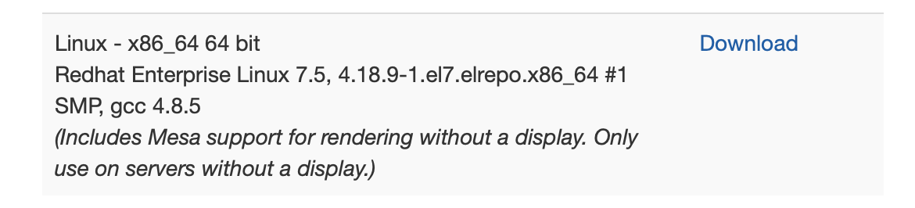
Installing VisIt on the cluster
Log on to the cluster and create a directory for the install. I used my home directory.
cd ~
mkdir visit
cd visit
Go to the VisIt website:
https://wci.llnl.gov/simulation/computer-codes/visit/executables
Download the last option in the list, which looks like:

Slide 5
Installing VisIt on the cluster (continued)
Upload the file to the directory you created (using the command line or WinSCP, Filezilla, etc.)
scp visit3_1_2.linux-x86_64-rhel7-wmesa.tar.gz gmhobson@dogwood.unc.edu:~/visit/
Extract the contents:
tar -xvf visit3_1_2.linux-x86_64-rhel7-wmesa.tar.gz
This will create a directory called
visit3_1_2.linux-x86_64
The syntax to use VisIt to run a Python script called ‘script.py’ is as follows.
You’ll need to change the line so that it contains the path to your visit directory.
/nas/longleaf/home/gmhobson/visit/visit3_1_2.linux-x86_64/bin/visit -cli -nowin -s script.py

Slide 6


Creating Python scripts to automate analysis
This part does involve using the GUI on your computer
Have a whitespace – sensitive text editor at the ready (Notepad ++, Visual Studio Code, etc.)
We create the Python scripts by recording the commands we are using in VisIt while we use them

Slide 7
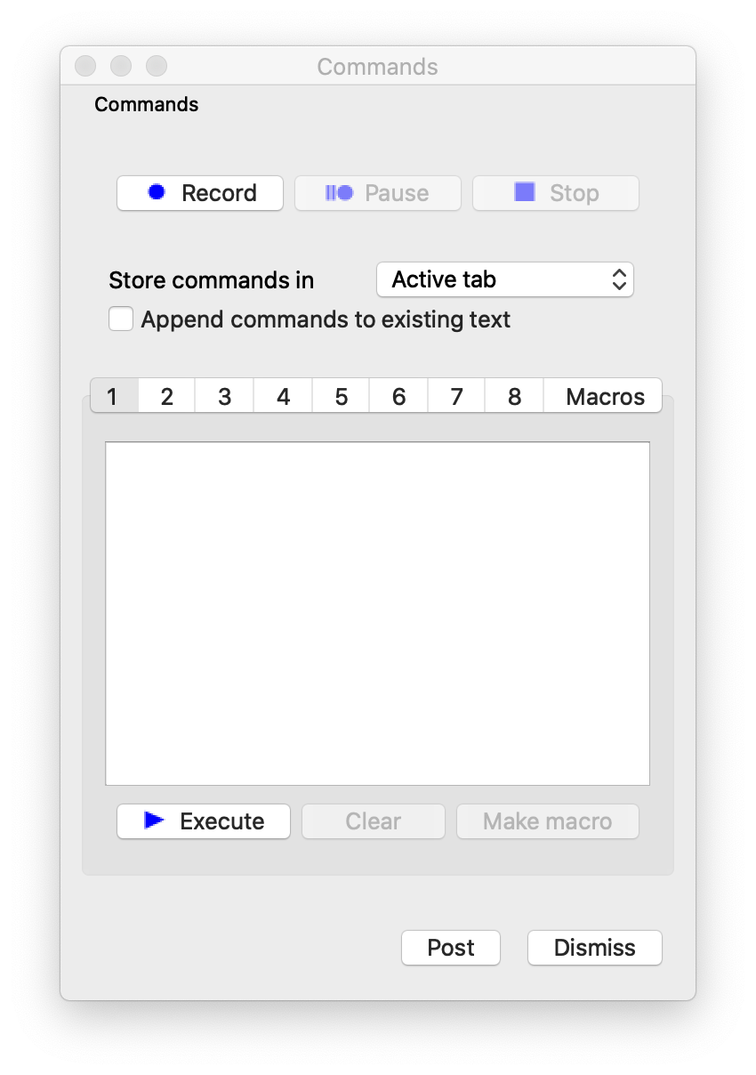
Recording commands
Click Controls → Command, or use the keyboard shortcut Control→ C (on Windows) or Command → Shift → C (on Mac).
Click Record to begin recording your commands.
Once you’ve completed the steps you want, click Stop.
Copy → Paste the code that appears in the box into your text editor.
You can follow these steps to create a script for the entire visualization process.

Slide 8
An Example
Throughout the next steps I will use the 2D rubber band example that is available on Laura’s GitHub:
https://github.com/fairyflies9/IBAMR-Tutorials/tree/master/Examples/3-Example_2Drubber_band

Slide 9
The start of your script: opening databases
Opening a database that contains your data is the first step.
Here, I open the dumps.visit data from the rubber band simulation:
OpenDatabase("localhost:/nas/longleaf/home/gmhobson/code/rubber_band/viz_IB2d/dumps.visit")
However, it’s a good idea to define the locations as strings at the start of your script.
string_dumps = "/21dayscratch/scr/g/m/gmhobson/flow_fields/rubber_band/dumps.visit"
string_mesh = "localhost/nas/longleaf/home/gmhobson/code/rubber_band/viz_IB2d/lag_data.visit”
Now I can easily refer to the locations of my dumps.visit data and my moving mesh data.
OpenDatabase(string_dumps)
OpenDatabase(string_mesh)
You can also specify a string for where you want to store the output (and refer to it later).
string_output = /21dayscratch/scr/g/m/gmhobson/flow_fields/rubber_band"

Slide 10
So far, the script looks like:
Adding in a database correlation and hiding the grid that shows up gives us this script.
# Example Script for IBAMR Tutorials
string_dumps = "localhost:/nas/longleaf/home/gmhobson/code/rubber_band/viz_IB2d/dumps.visit"
string_mesh = "localhost:/nas/longleaf/home/gmhobson/code/rubber_band/viz_IB2d/lag_data.visit"
string_output = "/21dayscratch/scr/g/m/gmhobson/flow_fields/rubber_band"
OpenDatabase(string_dumps)
OpenDatabase(string_mesh)
CreateDatabaseCorrelation("Correlation02",(string_dumps, string_mesh), 0)
SetActivePlots(0)
HideActivePlots()

Slide 11
Now for the fun part: visualizing data
As an example, here I plot the mesh as a first step.
AddPlot("Mesh", "rubber_band_512_mesh", 1, 0)
DrawPlots()
SetActivePlots(1)
MeshAtts = MeshAttributes()
MeshAtts.legendFlag = 0 # no legend
MeshAtts.lineWidth = 3 # thicker line
MeshAtts.meshColor = (0, 0, 128, 255) # nice dark blue
MeshAtts.meshColorSource = MeshAtts.MeshCustom
MeshAtts.pointSize = 0.05
MeshAtts.pointType = MeshAtts.Point
MeshAtts.pointSizePixels = 6 # larger points
MeshAtts.opacity = 1
SetPlotOptions(MeshAtts)
This isn’t every line that would show up when recording – just the ones I’m interested in

Slide 12
Visualizing data, continued
ActivateDatabase(string_dumps)
AddPlot("Pseudocolor", "U_magnitude", 1, 0)
PseudocolorAtts = PseudocolorAttributes()
PseudocolorAtts.minFlag = 1
PseudocolorAtts.min = 0
PseudocolorAtts.maxFlag = 1
PseudocolorAtts.max = 0.05
PseudocolorAtts.centering = PseudocolorAtts.Nodal
PseudocolorAtts.colorTableName = "plasma"
PseudocolorAtts.invertColorTable = 0
PseudocolorAtts.opacityType = PseudocolorAtts.FullyOpaque PseudocolorAtts.legendFlag = 1
PseudocolorAtts.lightingFlag = 1
SetPlotOptions(PseudocolorAtts)
DrawPlots()
Now for some color! I’m going to make a velocity pseudocolor plot. In 3d, this would be done on a slice.

Slide 13
Visualizing data, continued
Here I remove the axes, and the user and time data. Then I zoom in to the desired view. Note: commands to do with “spontaneous states”, like when you click the zoom icon in the GUI, do not work on the cluster.
AnnotationAtts = AnnotationAttributes()
AnnotationAtts.axes2D.visible = 0
AnnotationAtts.userInfoFlag = 0
AnnotationAtts.databaseInfoFlag = 0
AnnotationAtts.timeInfoFlag = 0
SetAnnotationAttributes(AnnotationAtts)
View2DAtts = View2DAttributes()
View2DAtts.windowCoords = (-0.185258, 0.188338, -0.15681, 0.150774)
View2DAtts.viewportCoords = (0.2, 0.95, 0.15, 0.95)
View2DAtts.windowValid = 1
SetView2D(View2DAtts)

Slide 14
Visualizing data, continued
Now to save each time step.
# saving images
SetTimeSliderState(0)
k=0 #Starting number: if left as 0, the first timestep to be saved will be 1
N=29 #Ending number: set this to the last timestep you wish to save, minus 1
while k<N+1:
TimeSliderNextState()
SaveWindowAtts = SaveWindowAttributes()
SaveWindowAtts.outputToCurrentDirectory = 0
SaveWindowAtts.outputDirectory = string_output
SaveWindowAtts.fileName = "rubber_band"
SaveWindowAtts.family = 1
SaveWindowAtts.format = SaveWindowAtts.PNG
SaveWindowAtts.width = 1024
SaveWindowAtts.height = 1024
SetSaveWindowAttributes(SaveWindowAtts)
SaveWindow()
k+=1

Slide 15
Running the script
When you’re ready, you can upload your script to the cluster and get ready to run it.
The syntax to run the script is in the form of:
path_to_VisIt_bin –cli –nowin –s name_of_script.py
In reality, if you’re executing this in the folder that contains your script, this looks like:
/nas/longleaf/home/gmhobson/visit/visit3_1_2.linux-x86_64/bin/visit -cli -nowin -s example_script.py
Once you’ve set your script running, you can check your output folder and make sure everything is coming in nicely.

Slide 16
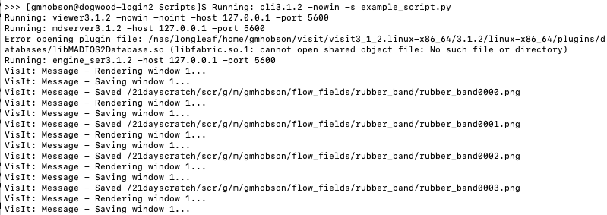
Running the script
The output in your terminal will look something like:

Slide 17
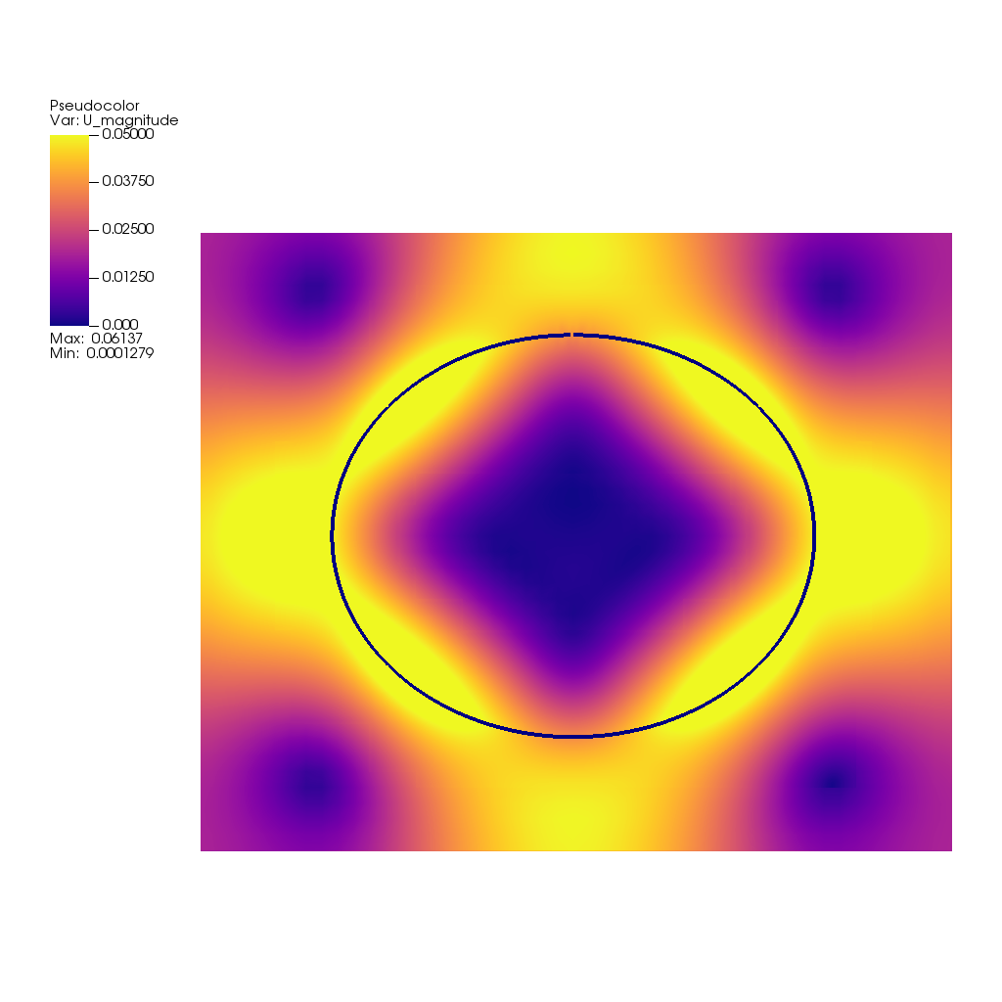
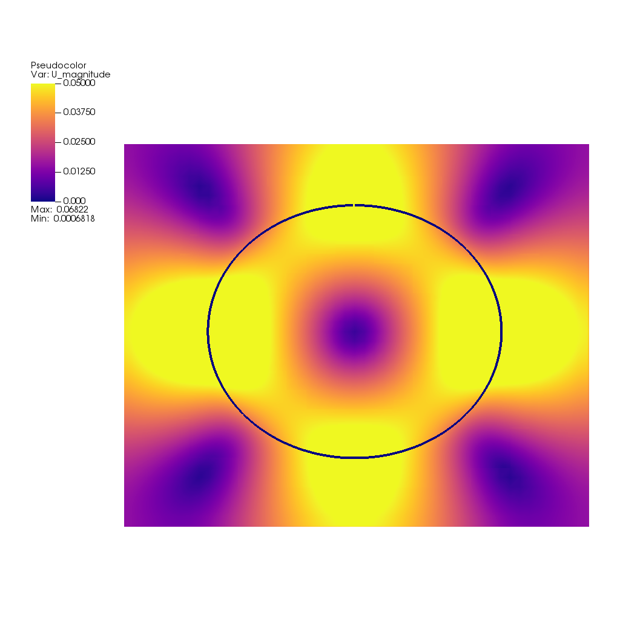
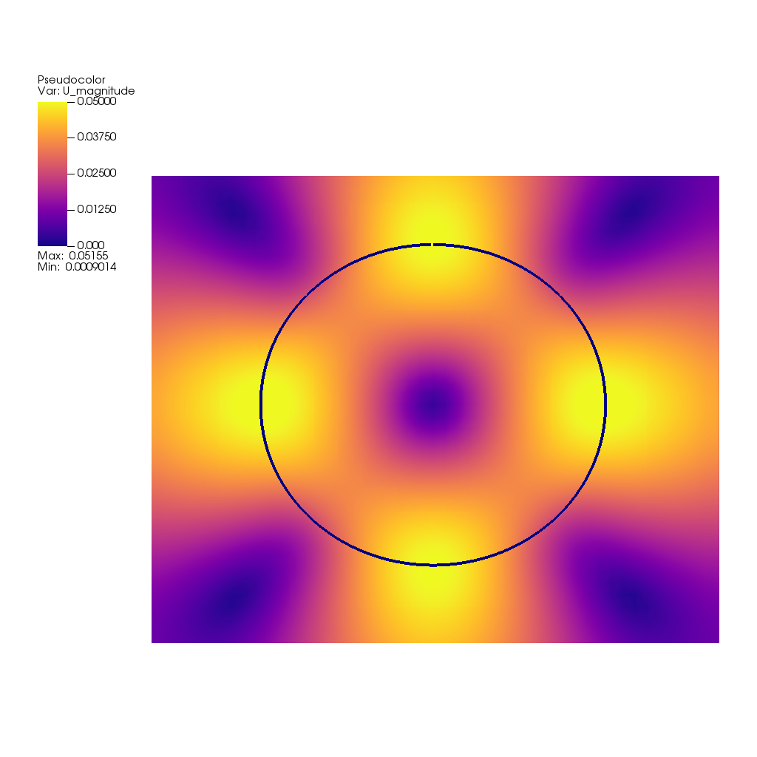
Running the script
The result in your output folder should be .png files that look like:

Slide 18
IBFE Meshes and Displacement Operators
IBFE, unlike what we were doing in IBAMR, has meshes that will require a displacement operator to get them to move.
In a previous lecture, Laura covered implementing this in the VisIt GUI, and I’m including the code here that will work in scripts on the cluster.
One thing to note is the line that sets the smoothing level: SubsetAtts.smoothingLevel = 2.
This sets the smoothing level to High and gives a better-looking result than None or Fast ( 0 or 1 in the script), at least for the 3d coral meshes.

Slide 19
IBFE Meshes and Displacement Operators, cont.
OpenDatabase(string_mesh)
AddPlot("Subset", "Mesh", 1, 0)
SetActivePlots(1)
AddOperator("Displace", 0)
DefineVectorExpression("dX", "{dX_0,dX_1,dX_2}")
DisplaceAtts = DisplaceAttributes()
DisplaceAtts.factor = 1
DisplaceAtts.variable = "dX"
SetOperatorOptions(DisplaceAtts, 0, 0)
SubsetAtts = SubsetAttributes()
SubsetAtts.colorType = SubsetAtts.ColorBySingleColor
SubsetAtts.singleColor = (255, 255, 255, 255)
SubsetAtts.subsetNames = ("Whole mesh (Mesh)")
SubsetAtts.smoothingLevel = 2
SubsetAtts.pointSize = 0.05
SubsetAtts.pointType = SubsetAtts.Point
SetPlotOptions(SubsetAtts)
DrawPlots()

Slide 20
Resampling velocity fields in 3D
Resampling velocity fields in 3D will give better results when plotting velocity vectors or when spatially averaging velocity components.
Resampling creates a .VTK database that you can then call in other scripts. However, on the cluster VisIt has trouble reading .VTK databases.
The workaround is to copy a dumps.visit file into the .VTK database directory.
Then edit it so that it contains a list of the names of all the .vtk files.
This dumps.visit file can be called in the OpenDatabase() command, and it opens the .VTK database.

Slide 21
Resampling a 3D velocity field, cont.
OpenDatabase(string_dumps)
AddPlot("Vector", "U", 1, 0)
AddOperator("Resample", 0)
SetActivePlots(1)
SetActivePlots(1)
ResampleAtts = ResampleAttributes()
ResampleAtts.useExtents = 0
ResampleAtts.startX = -0.0375
ResampleAtts.endX = 0.0375
ResampleAtts.samplesX = 192
ResampleAtts.startY = -0.007
ResampleAtts.endY = 0.018
ResampleAtts.samplesY = 64
ResampleAtts.is3D = 1
ResampleAtts.startZ = -0.0075
ResampleAtts.endZ = 0.0075
ResampleAtts.samplesZ = 32
SetOperatorOptions(ResampleAtts, 0)
DrawPlots()
It’s a good idea to check that the extents of your domain in each direction divided by the number of samples gives you the same number (i.e. you have a uniform grid).

Slide 22
VectorAtts = VectorAttributes()
VectorAtts.glyphLocation = VectorAtts.UniformInSpace
VectorAtts.useStride = 0
VectorAtts.stride = 1
VectorAtts.nVectors = 393216
VectorAtts.lineStyle = VectorAtts.SOLID
VectorAtts.lineWidth = 0
VectorAtts.scale = 0.25
VectorAtts.scaleByMagnitude = 1
VectorAtts.autoScale = 1
VectorAtts.headSize = 0.25
VectorAtts.headOn = 1
VectorAtts.colorByMag = 1
VectorAtts.useLegend = 1
VectorAtts.vectorColor = (0, 0, 0, 255)
SetPlotOptions(VectorAtts)
TimeSliderNextState()
Resampling a 3D velocity field, cont.
The important thing here is to match the number of vectors (nVectors) to the product of the number of xSamples, ySamples, and zSamples.

Slide 23
ExportDBAtts = ExportDBAttributes()
ExportDBAtts.allTimes = 1
ExportDBAtts.db_type = "VTK"
ExportDBAtts.db_type_fullname = "VTK_1.0"
ExportDBAtts.filename = "visit_ex_db"
ExportDBAtts.dirname = string_output
ExportDBAtts.variables = ("U", "U_x", "U_y", "U_z")
ExportDBAtts.writeUsingGroups = 0
ExportDBAtts.groupSize = 48
ExportDBAtts.opts.types = (0, 0)
ExportDBAtts.opts.help = ""
ExportDatabase(ExportDBAtts)
Resampling a 3D velocity field, cont.
This exports your resampled velocity field at each timestep.

Slide 24
Accessing a .VTK database
In a different script, you can open the .VTK database (once you’ve added the dumps.visit file containing the filenames).
string_vtk = "localhost:/path_to_vtk_database/dumps.visit"
OpenDatabase(string_vtk)
Resampling and exporting to create these databases is much, much faster on the cluster.

Slide 25
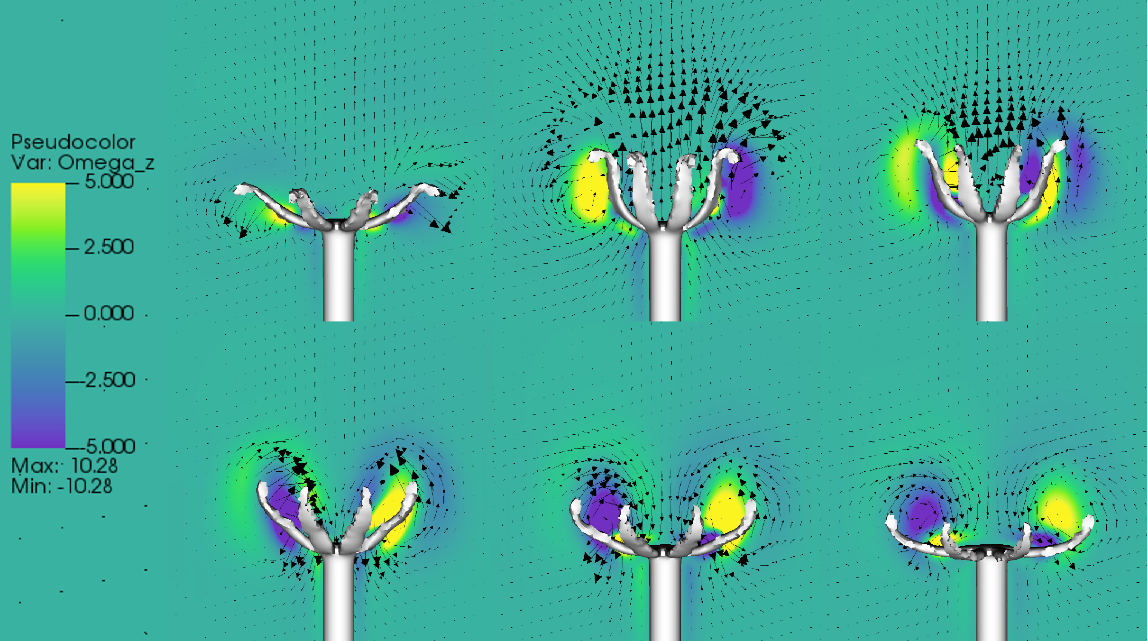
Using .VTK databases
The .VTK database can be useful to plot uniform velocity vectors on a slice:

Slide 26
Using .VTK databases – Averaging Velocity
The .VTK database can also be used for spatial averaging. This script plots a pseudocolor of the vertical velocity in a box in the domain. Then it averages in that box over time.
OpenDatabase(string_vtk)
AddPlot("Pseudocolor", "U_y", 1, 0)
AddOperator("Box", 0)
SetActivePlots(0)
BoxAtts = BoxAttributes()
BoxAtts.amount = BoxAtts.Some # Some, All
BoxAtts.minx = -0.0075
BoxAtts.maxx = 0.0075
BoxAtts.miny = 0.0043
BoxAtts.maxy = 0.0097
BoxAtts.minz = -0.0075
BoxAtts.maxz = 0.0075
BoxAtts.inverse = 0
SetOperatorOptions(BoxAtts, 0)
DrawPlots()

Slide 27
Using .VTK databases – Averaging Velocity, cont.
A query over time performs the temporal average.
You can set the end_time to a very high number and VisIt will automatically clamp to the number of timesteps you have. This way you don’t accidentally cut your query short.
SetActivePlots(0)
QueryOverTimeAtts = GetQueryOverTimeAttributes()
QueryOverTimeAtts.timeType = QueryOverTimeAtts.DTime # Cycle, DTime, Timestep
QueryOverTimeAtts.startTimeFlag = 0
QueryOverTimeAtts.startTime = 0
QueryOverTimeAtts.endTimeFlag = 0
QueryOverTimeAtts.endTime = 1
QueryOverTimeAtts.strideFlag = 0
QueryOverTimeAtts.stride = 1
QueryOverTimeAtts.createWindow = 0
QueryOverTimeAtts.windowId = 2
SetQueryOverTimeAttributes(QueryOverTimeAtts)
SetQueryFloatFormat("%g")
QueryOverTime("Average Value", end_time=1000, start_time=0, stride=1)

Slide 28
Using .VTK databases – Averaging Velocity, cont.
Finally, you can save your average as a .curve file. This can be opened and plotted in Matlab.
The .curve file will have a line at the very beginning with text preceded by a #. This will prevent it loading as a matrix in Matlab, but you can open the file and remove it manually.
SetActiveWindow(2)
SaveWindowAtts = SaveWindowAttributes()
SaveWindowAtts.outputToCurrentDirectory = 0
SaveWindowAtts.outputDirectory = "."
SaveWindowAtts.fileName = "avg_uy"
SaveWindowAtts.family = 1
SaveWindowAtts.format = SaveWindowAtts.CURVE
SetSaveWindowAttributes(SaveWindowAtts)
SaveWindow()

Slide 29
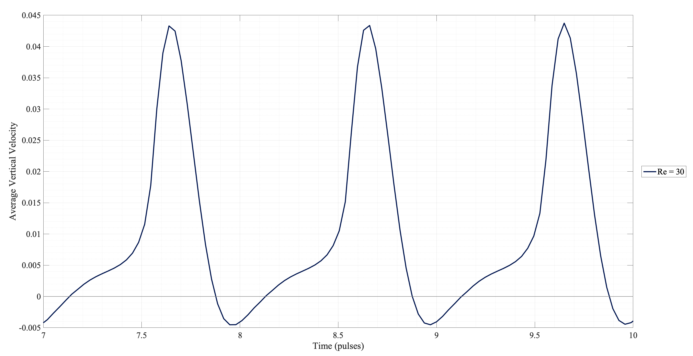
Using .VTK databases – Averaging Velocity, cont.
An example of a .curve file plotted in Matlab is:

Slide 30
Restarting a job
If you want to restart a job that has unexpectedly stopped, add the path to the restart_IB3d directory and the number of the last restart file to your submission script.
#!/bin/bash
#SBATCH --job-name=re48
#SBATCH --ntasks-per-node=44
#SBATCH -N 4
#SBATCH --time=72:00:00
#SBATCH --partition=528_queue
#SBATCH --output output
mpirun ./main3d input3d $PWD/restart_IB3d 995000

Slide 31

Things to remember
These Python scripts are whitespace sensitive
Errors that pop up in your command line should have the line number in them, this will help with debugging
If you change the order in which you do things, you may need to change the number in the SetActivePlots() command.
Having a good structure for your input and output file directories will save you time and confusion

Slide 32

Useful Resources
Of course, all of Laura’s tutorials and examples:
https://github.com/fairyflies9/IBAMR-Tutorials
The VisIt user manuals, for information about what different types of analysis do:
https://visit-sphinx-github-user-manual.readthedocs.io/en/develop/index.html
Shannon Jones’ YouTube tutorials:
https://www.youtube.com/channel/UC04G0vw4uKhLYiBbcgHqWrg

